Slide 1
Food Deserts and Diabetes Prevalence
Using explanatory modeling techniques to explore the relationship between grocery access and diabetes
By: Emily Donofrio

Slide 2
Agenda
Key Question & Literature Review
Data Sources, Variables, Preprocessing, & EDA
Modeling Methods & Results
Conclusions & Comments

Slide 3
Agenda
Key Question & Literature Review
Data Sources, Variables, Preprocessing, & EDA
Modeling Methods & Results
Conclusions & Comments

Slide 4
Do food deserts have an adverse effect on health, as explored by the relationship with diabetes prevalence?
What are food deserts?
“geographic areas where residents’ access to affordable, healthy food options (especially fresh fruits and vegetables) is restricted or nonexistent due to the absence of grocery stores within convenient traveling distance”*
Previous Studies
Seligman et al. (2007)
Key Finding: “After adjusting for sociodemographic factors and physical activity level, participants with severe food insecurity were more likely to have diabetes than those without food insecurity”
Independent Variable: Food insecurity categorization groupings using National Health Examination and Nutrition Examination Survey data
Dependent Variable: Self-reported diabetes diagnosis, excluding Type I
Berkowitz et al. (2018)
Key Finding: “Food insecurity is associated with higher HbA_{1c}, but living in an area with low physical food access is not”
Independent Variable: Food insecurity survey, low food access (LA1and10)
Dependent Variable: HbA_{1c} from electronic medical records of diabetes patients
*Source: https://foodispower.org/access-health/food-deserts/
Notes:
Explanatory modeling!! Looking to isolate causal effect of food deserts on diabetes prevalence

Slide 5
Agenda
Key Question & Literature Review
Data Sources, Variables, Preprocessing, & EDA
Modeling Methods & Results
Conclusions & Comments

Slide 6
I am using two datasets sourced from USDA and CDC data from 2019
USDA: Food Access Research Atlas
  Granularity: Census tract
  72531 rows at census level, 3142 counties
  2019 list of supermarkets, the 2010 Decennial Census, and the 2014-18 American Community Survey (ACS)
  Multiple measures of food accessibility, sociodemographic data of census tracts
CDC: Diagnosed Diabetes Prevalence
  Granularity: County
  3120 rows
  Rate of diagnosed diabetes prevalence, all types of diabetes
Notes:
All data publically available on government websites, all aggregated so no identifying information

Slide 7
I had 2 variables of interest and other potentially confounding variables I chose to help isolate causal effect
Outcome Variable: Diabetes Prevalence - rate, 0-1
X Variable of Interest: LA1and10 - binary at tract level
  A tract with at least 500 people, or 33 percent of the population, living more than 1 mile (urban areas) or 10 miles (rural areas) from the nearest supermarket, supercenter, or large grocery store.
Other X variables: 'Pop2010', 'Urban', 'PovertyRate', 'MedianFamilyIncome', 'CountyKids_percent', 'CountySeniors_percent', 'CountyWhite_percent', 'CountyBlack_percent', 'CountyAsian_percent', 'CountyHispanic_percent', 'CountySNAP_percent'

Slide 8
There were multiple preprocessing steps to create the modeling dataset
Removing unnecessary columns
Aggregating food access to county, state level
  Used weighted averages by census tract population for LA1and10, urban, poverty_rate, and median income
  Summed population and population subgroups, created percentages of county
Joining diabetes and food access data on county and state
  Inner join, as the analysis requires values for both diabetes prevalence and LA1and10
  Checked which observations in both datasets did not have matches, cleaned data to pick up more matches
  Finding: Diabetes dataset does not have NJ data, meaning there is no New Jersey data in the final dataset

Slide 9
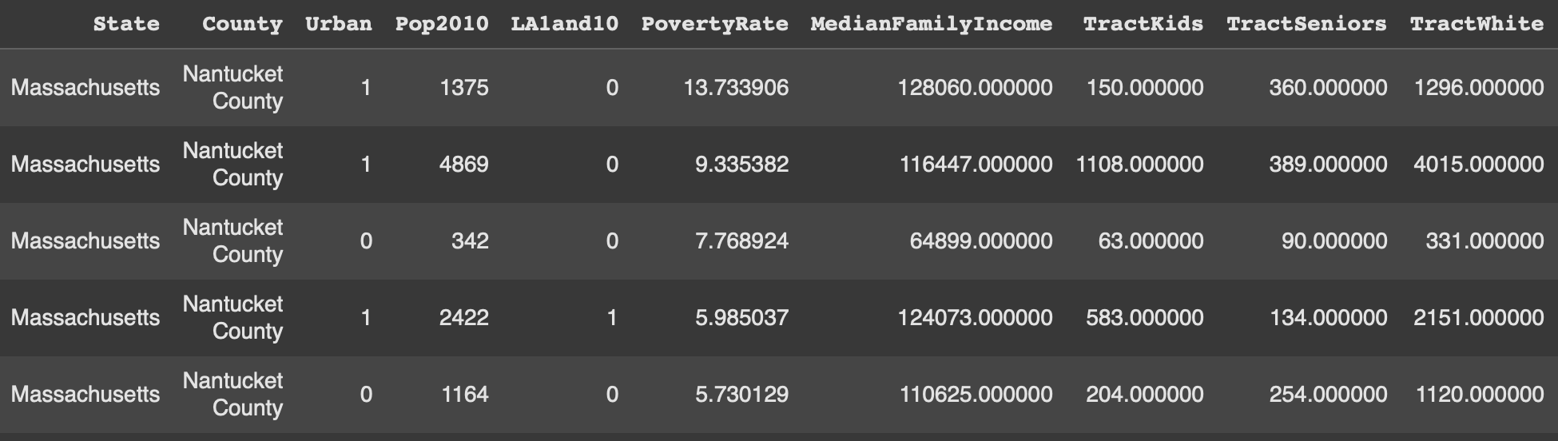
Aggregation example: Nantucket County, MA

Slide 10
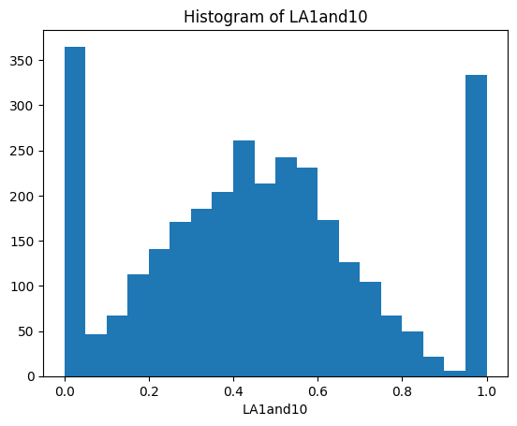
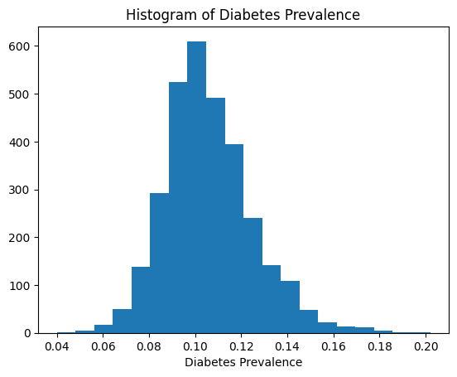
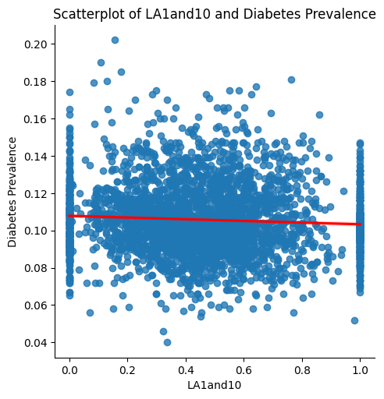
EDA showed a slight negative relationship between LA1and10 and diabetes prevalence
EDA Takeaways:
LA1and10 extends full range [0,1], modes at 0 and 1
Diabetes prevalence fairly normal distribution
Very slight negative relationship between LA1and10 and diabetes prevalence

Slide 11
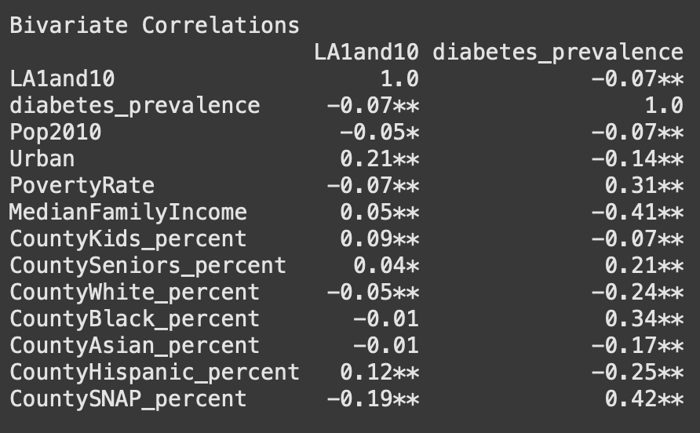
All of the variables seem to have a significant correlation with diabetes prevalence
Takeaways:
LA1and10 weak negative correlation but significant at 0.01 level
Strongest correlations are with SNAP percent, and Median Family Income

Slide 12
Agenda
Key Question & Literature Review
Data Sources, Variables, Preprocessing, & EDA
Modeling Methods & Results
Conclusions & Comments

Slide 13
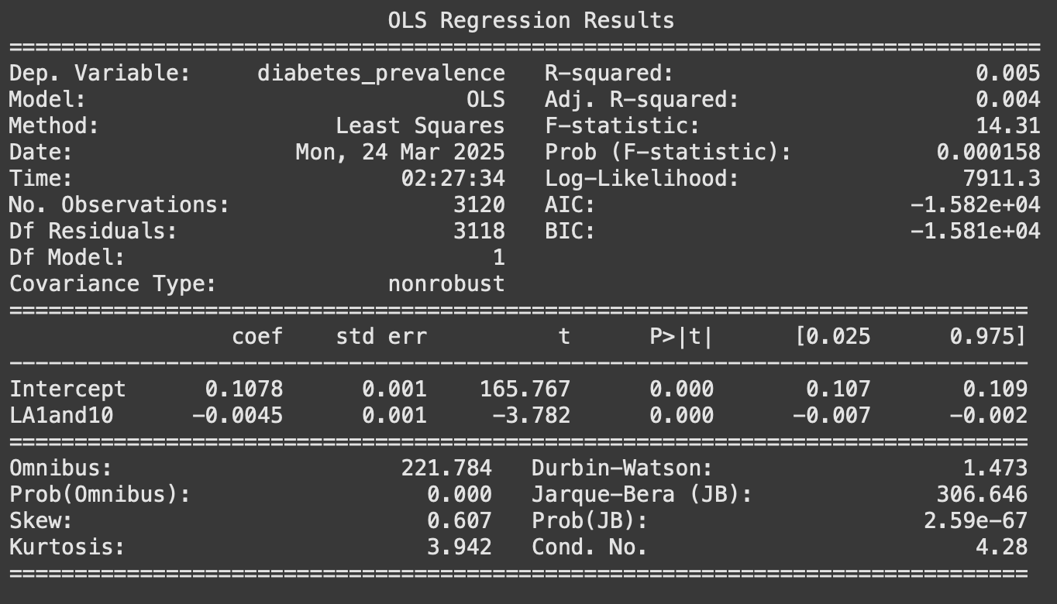
OLS Model 1: Simple Linear Regression
Hypotheses:
H0: R² = 0, there is no significant shared variance between LA1and10 and diabetes prevalence
H1: R² ≠ 0, there is some significant shared variance between LA1and10 and diabetes prevalence
H0: β_{LA1aand10} = 0, the regression coefficient of LA1and10 is equal to 0
H1: β_{LA1aand10} ≠ 0, the regression coefficient of LA1and10 is not equal to 0
Equation: Diabetes Prevalence = 0.1070 +
-0.0045*LA1and10
P-value of coefficient: < 0.001
Interpretation: Every 1 percentage point increase in LA1and10 is associated with a 0.0045 percentage point decrease in diabetes prevalence. From 0 LA1and10 to 1, the total change is expected to be a 0.45 percentage point decrease.
Notes:
0.5% of the variance in diabetes prevalence can be explained by the variance in low food access at 1 and 10 miles, in general for explanatory modeling though we aren’t looking to maximize R-squared, just look at significance and magnitude of the regression coefficient of the variable of interest

Slide 14
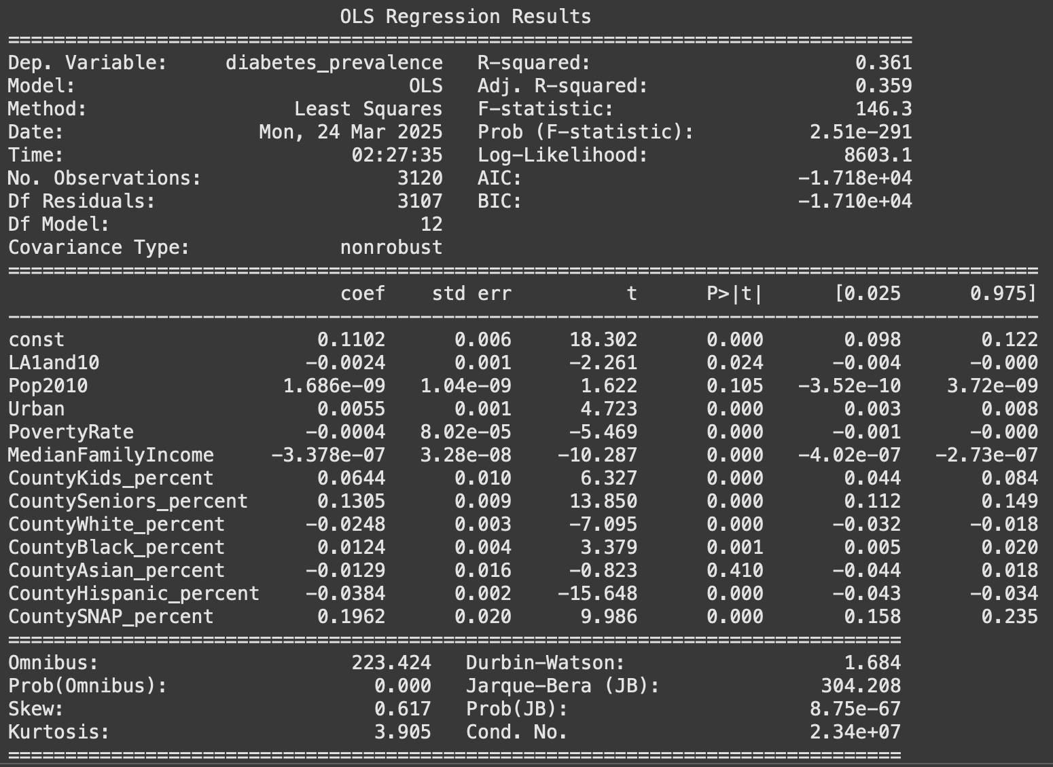
OLS Model 2: Adding potential confounding variables
Hypotheses:
H0: β_{LA1aand10} = 0, the regression coefficient of LA1and10 is equal to 0
H1: β_{LA1aand10} ≠ 0, the regression coefficient of LA1and10 is not equal to 0
Coefficient of LA1and10: -0.0024
P-value of coefficient: 0.024
Interpretation: Every 1 percentage point increase in LA1and10 is associated with a 0.0024 percentage point decrease in diabetes prevalence, holding all else equal. From 0 LA1and10 to 1, the total change is expected to be a 0.24 percentage point decrease.

Slide 15
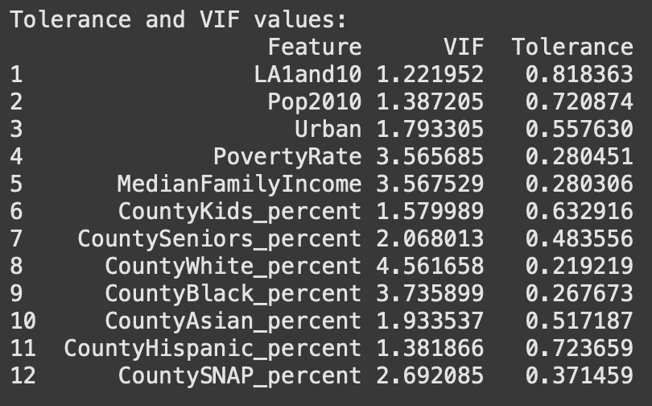
Checking Assumptions: Multicollinearity
None of the features have a VIF > than 5 or a tolerance < 0.2, so multicollinearity does not appear to be a major concern
The variable of interest, LA1and10 has a VIF of 1.22 and a tolerance of 0.8183 meaning that 81% of its variance is independent of the other variables.

Slide 16
Agenda
Key Question & Literature Review
Data Sources, Variables, Preprocessing, & EDA
Modeling Methods & Results
Conclusions & Future Considerations

Slide 17
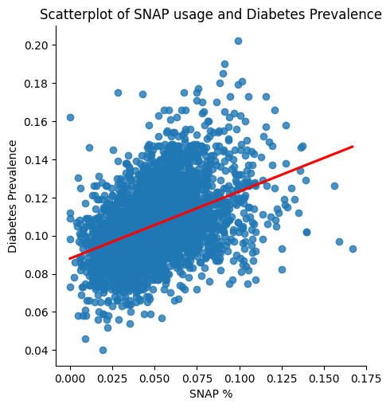
Low physical food access itself does not have a positive causal effect on diabetes prevalence
From analysis, we see that low food access has a slight negative if any effect on diabetes prevalence
This aligns with the findings of previous literature:
  Berkowitz et al - low food access itself does not have a direct effect on diabetes, but food insecurity whole does
If we use SNAP as an indicator for food insecurity, then we see that it has a much stronger and positive relationship with diabetes prevalence.
Notes:
SNAP % had regression coefficient of 0.196 - meaning that Every 1 percentage point increase in SNAP usage is associated with a 0.196 percentage point increase in diabetes prevalence, holding all else equal. From 0% of the county on SNAP to 100% of the county on SNAP, the total change is expected to be a 19.6 percentage point increase.

Slide 18
Future considerations
Alternative aggregation methods (eg: keeping LA1and10 binary)
Repeat analysis with alternative food desert indicators (eg: LA1and20)
Using census tract or individual granularity to increase accuracy, detail, and potential variables to include
Investigating the effects of food deserts on other health outcomes

Slide 19
References:
Berkowitz, S. A., Karter, A. J., Corbie-Smith, G., Seligman, H. K., Ackroyd, S. A., Barnard, L. S., Atlas, S. J., & Wexler, D. J. (2018). Food insecurity, food “deserts,” and glycemic control in patients with diabetes: A longitudinal analysis. Diabetes Care, 41(6), 1188–1195. https://doi.org/10.2337/dc17-1981
Rural Health Information Hub. (n.d.). Rural data explorer. Retrieved March 12, 2025, from https://www.ruralhealthinfo.org/data-explorer?id=192
Seligman, H.K., Bindman, A.B., Vittinghoff, E. et al. Food Insecurity is Associated with Diabetes Mellitus: Results from the National Health Examination and Nutrition Examination Survey (NHANES) 1999–2002. J GEN INTERN MED 22, 1018–1023 (2007). https://doi.org/10.1007/s11606-007-0192-6
Economic Research Service (ERS), U.S. Department of Agriculture (USDA). Food Access Research Atlas, https://www.ers.usda.gov/data-products/food-access-research-atlas/

Slide 20
Thank you! Questions?

